Slide 1
AMPIL Investor Update
October 2022

Slide 2
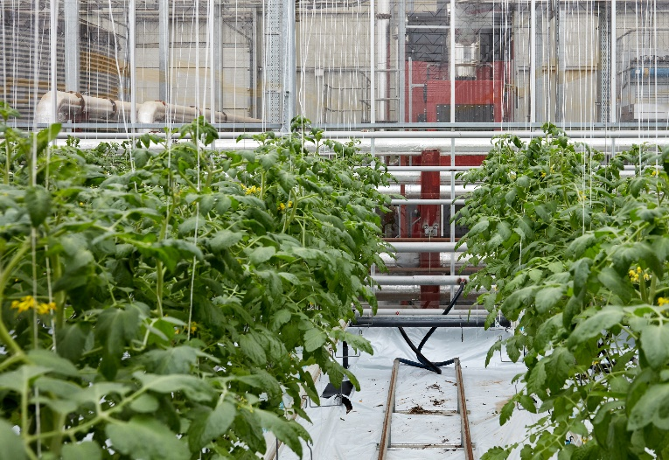
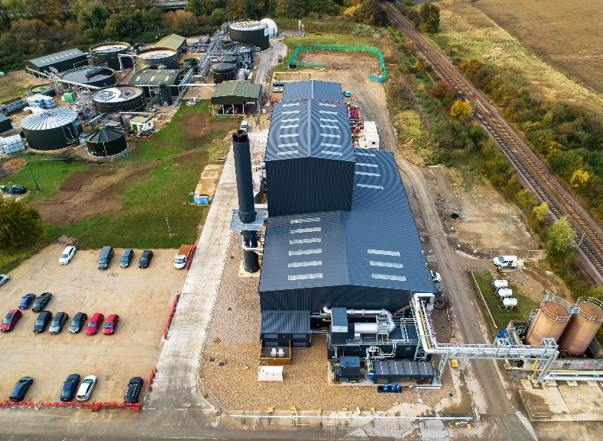
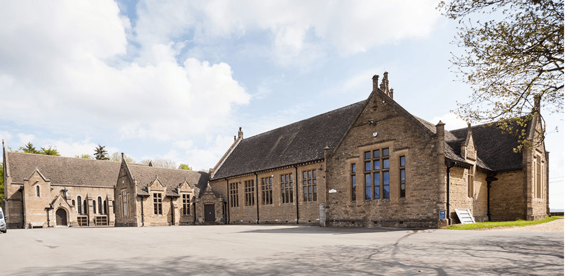
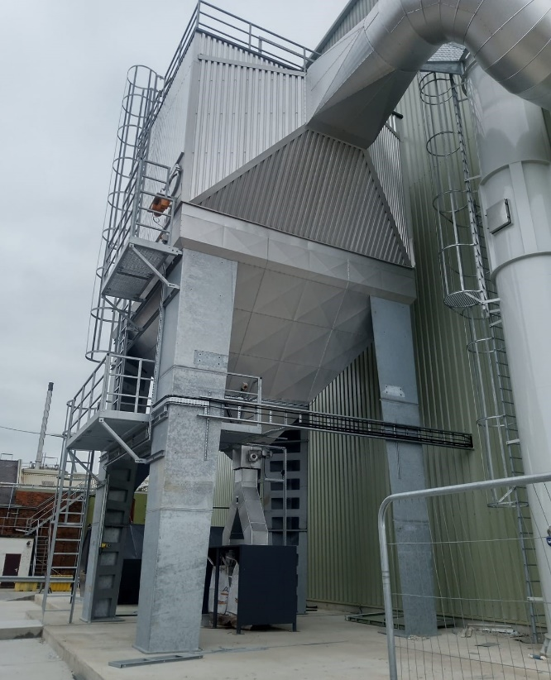
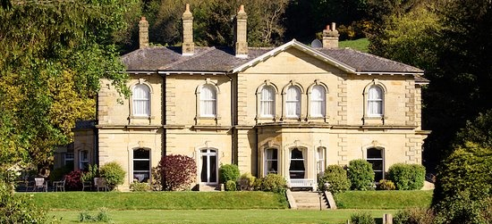
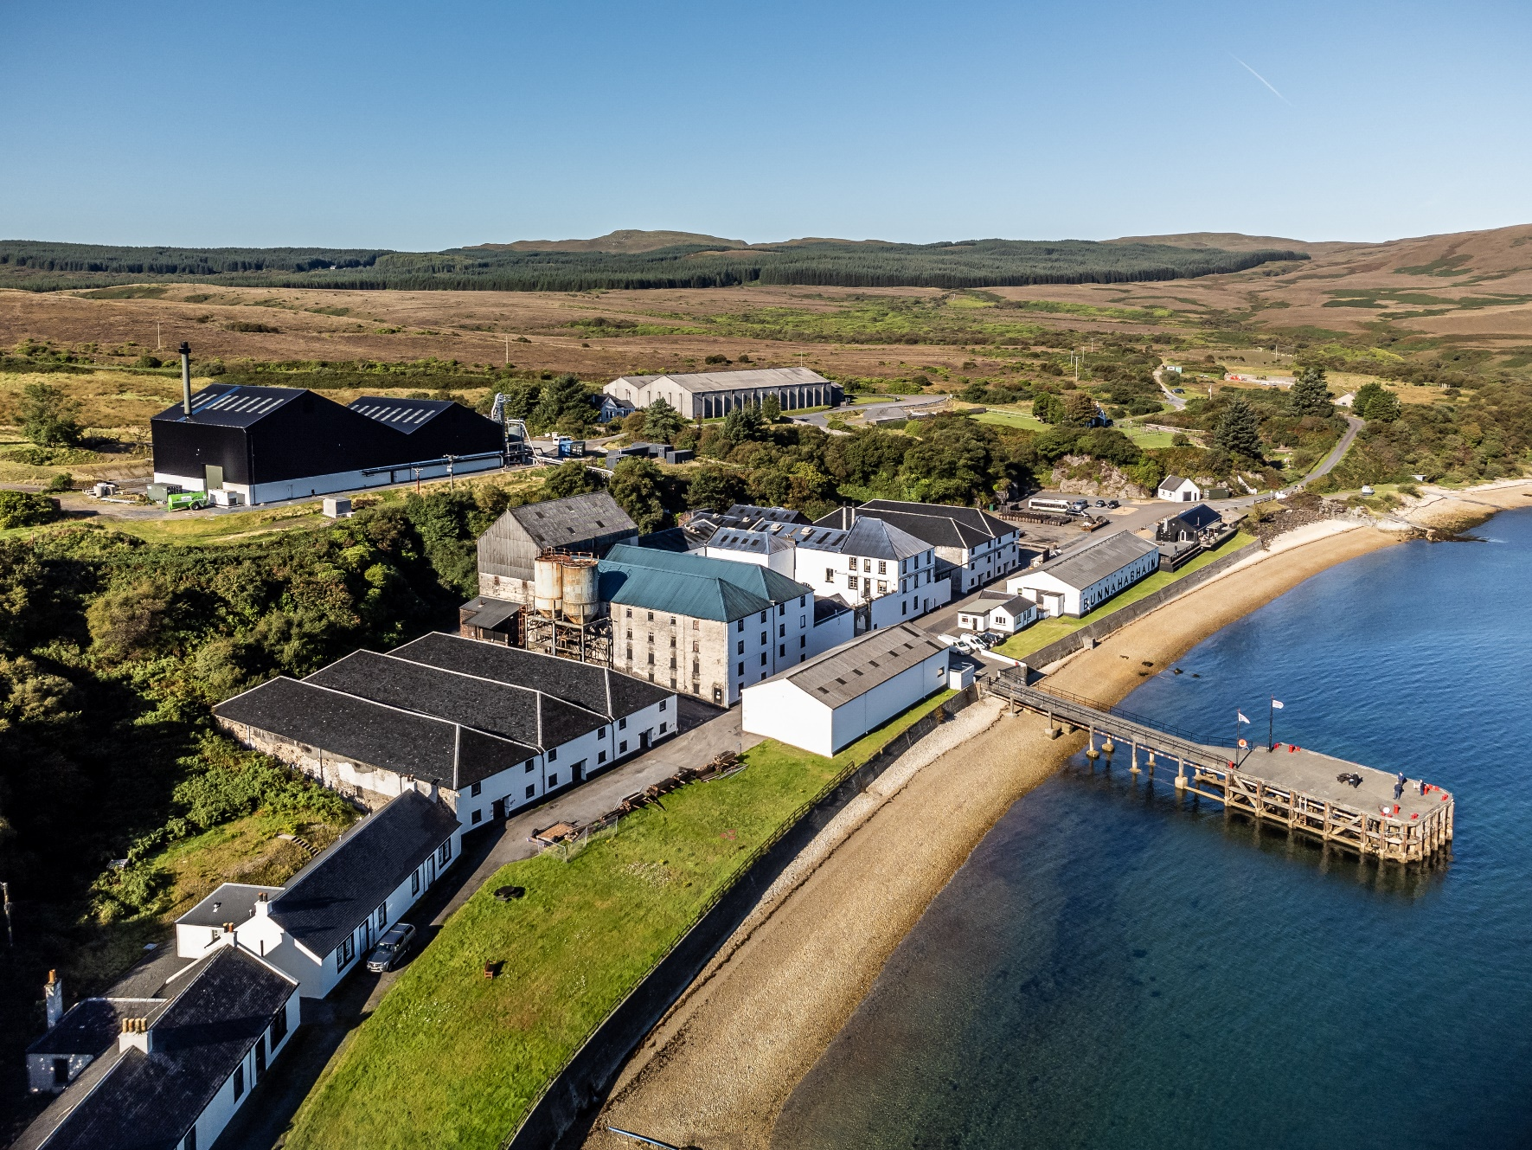
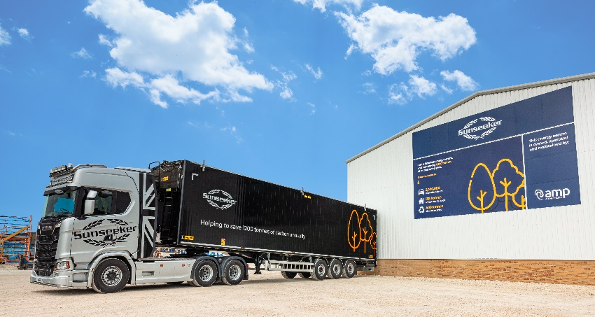
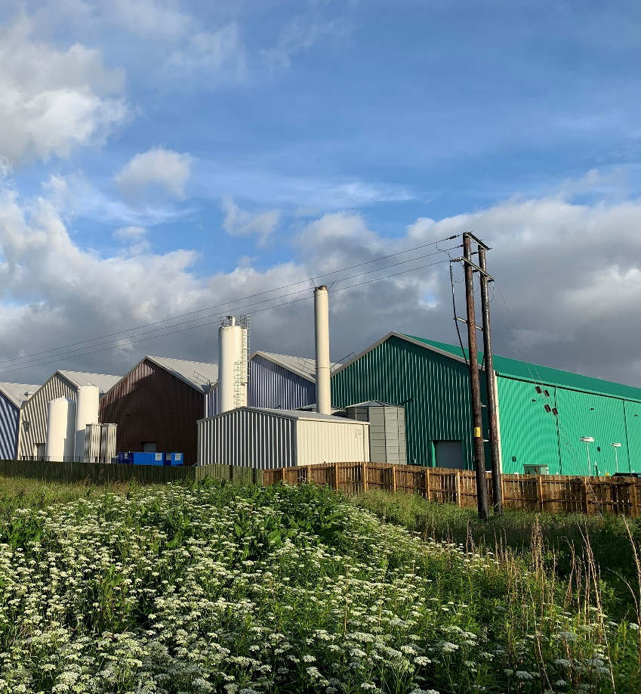
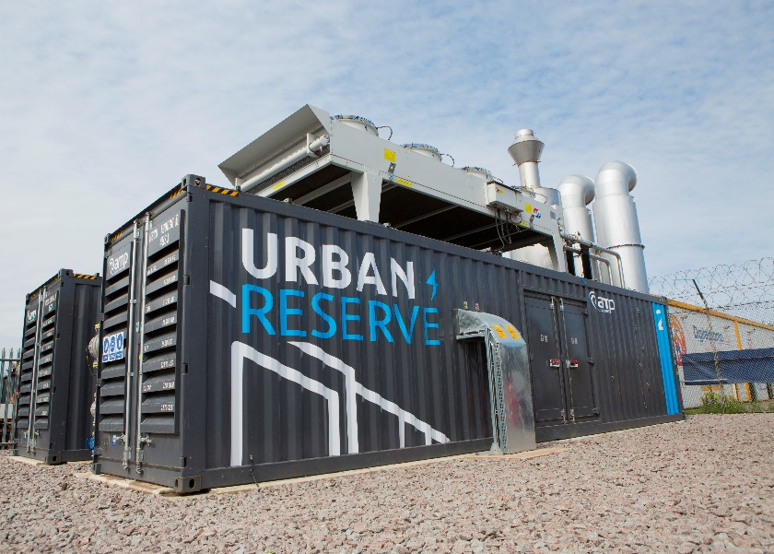
Villa Nursery
Muntons
Kingham Hill School
Cargill
Hackness Grange Hotel
Bunnahabhain
Sunseeker
Scottish Sea Farms
Heysham Power
Notes:
In the last 3 years we have
Built 48MW of new biomass (more than doubling our capacity)
Built (or soon to have) 123MW of UR across 30 sites
Turned ABFL profitable for the first time
Its been a huge collective effort……

Slide 3
Summary
AMPIL is a company of real purpose: we decarbonise heat and help keep the lights on
AMPIL comprises 87MW of biomass and 123MW of Urban Reserve, all now operational
The portfolio is performing well and is now highly cash generative
AMPIL benefits from a direct link to rising inflation (via the RHI) and the shortage of (flexible) electricity generation capacity across Europe
AMPIL has managed to forward hedge 32MW-44MW (or 26%-36% of electricity generation capacity, depending on the month) locking in a gross margin of £18.3m this winter
The proposed refinancing process has taken longer than ever anticipated, and during this period swap rates have increased markedly
Proposed lending margins have not changed during the refinancing process
Market volatility means that AMP is exposed to considerable pricing uncertainty between signing documents and fixing swap rates because of lender notice periods

Slide 4
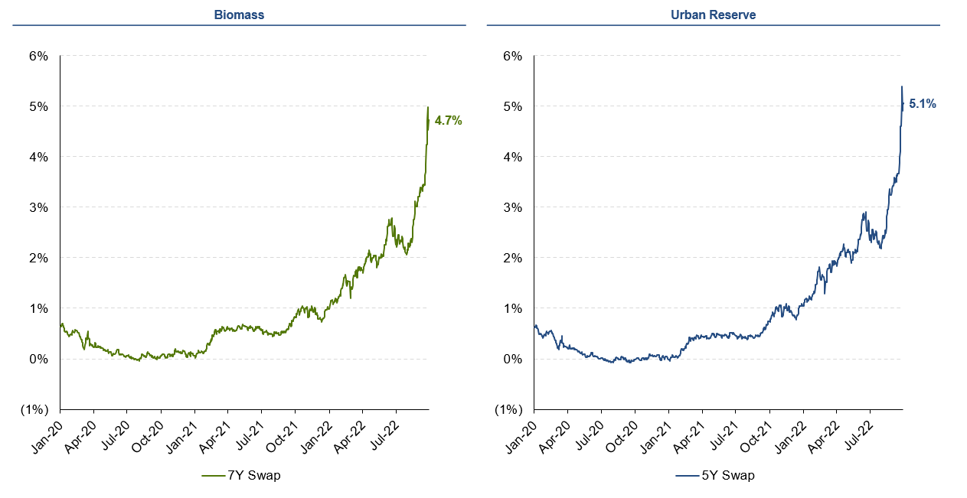
Growth in swap rates
AMPIL’s weighted average cost of the refi is approximately 8.8%* plus 3% call premium
Refi cost = c 8%
Refi cost = c 9.75%
*Swap rates as of Monday 3 October. Need to add c 25bps credit charge to swaps for funding rate

Slide 5
Strong growth in operating cash flows
Audited accounts
Management accounts*
Management accounts*
Management accounts*
*12 month numbers in respect of March 2022, June 2022 and August 2022 are from unaudited management accounts, and may be subject to change during the audit process

Slide 6
Debt coverage
Total Asset Value = £209m
Total Funding = £209m
Unleveraged NPV/Debt amount
AMPIL NPV = £209m
Lifetime* Biomass Operating Cash Flows = £176m
Lifetime* UR Operating Cash Flows = £238m
(*Based on management forecasts)
discounted at 10%
NPV Biomass Operating Cash Flows = £88m
NPV UR Operating Cash Flows = £121m
Externally held Loan Notes = £114.9m
Debt =55% LTV
Subordinated debt/equity = £94.1m
(Includes £29.1m of Loan notes owned by AMP which have been subordinated to all other noteholders, of which £25.1m is non interest bearing)
Value of operating assets
Debt/equity amount

Slide 7
Disclaimer
These presentation slides and any accompanying verbal presentation (the “Presentation Materials”) do not constitute or form part of any invitation, offer for sale or subscription or any solicitation for any offer to buy or subscribe for any securities in Aggregated Micro Power Holdings Limited (the "Company") or any of its subsidiaries or affiliates including but not limited to Aggregated Micro Power Infrastructure 2 plc (the “Group”) (“Group Securities”) nor shall they or any part of them form the basis of or be relied upon in connection with, or act as any inducement to enter into, any contract or commitment with respect to Group Securities. These Presentation Materials do not constitute a recommendation regarding any decision to sell or purchase Group Securities. The Company reserves the right to change information in the Presentation Materials without notice.
This presentation is not for retail persons / investors. The content of these Presentation Materials has not been approved by an authorised person within the meaning of the Financial Services and Markets Act 2000 (“FSMA”). Reliance on the Presentation Materials for the purpose of engaging in any investment activity may expose an individual to a significant risk of losing all of the property or other assets invested. Any person who is in any doubt about the subject matter to which this presentation relates should consult a person duly authorised for the purposes of FSMA who specialises in the acquisition of shares and other securities.
The Presentation Materials includes statements that are, or may be deemed to be, forward-looking statements. These forward-looking statements can be identified by the use of forward-looking terminology, including the terms "believes", "estimates", "plans", "projects", "anticipates", "expects", "intends", "may", "will", or "should" or, in each case, their negative or other variations or comparable terminology. These forward-looking statements include matters that are not historical facts and include statements regarding the Group's intentions, beliefs or current expectations concerning, among other things, the anticipated future performance of the Group. Any such forward-looking statements in the Presentation Materials reflect the Group’s current expectations and projections about future events but, by their nature, forward-looking statements involve a number of risks, uncertainties and assumptions that could cause actual results or events to differ materially from those expressed or implied by the forward-looking statements. These risks, uncertainties and assumptions could adversely affect the outcome and financial effects of the plans and events described herein. Save as required by law or regulation or the rules of any securities exchange, the Company and the Group undertakes no obligation to release the results of any revisions to any forward-looking statements in this Presentation that may occur due to any change in its expectations or to reflect events or circumstances after the date of the Presentation Materials. In particular, no representation or warranty is given by the Company or the Group as to the achievement of, and no reliance should be placed on, any projections, targets, estimates or forecasts and nothing in the Presentation Materials is or should be relied on as a promise or representation as to any future event.
The financial information included in the Presentation Materials has not been audited, reviewed or verified by any independent accounting firm, is based on our management accounts and relies on management judgment. This financial information is inherently subject to risks and uncertainties and it may not give an accurate or complete picture of the financial condition or results of operations of the Group for the periods presented. In making an investment decision, investors must rely upon their own examination of the publicly available financial information and should consult their own professional advisors for an understanding of applicable accounting principles and how these may affect any such financial information.
While this information has been prepared in good faith, no representation or warranty, express or implied, is or will be made and no responsibility or liability is or will be accepted by the Company or the Group, or by any of its respective directors, officers, employees and agents in relation to the accuracy or completeness of this document and any such liability is expressly disclaimed. To the maximum extent permitted by law, and except in the case of fraud, the Company and the Group and their respective directors, officers, employees and agents expressly disclaim any liability which may arise from this presentation, or any other written or oral information provided in connection therewith, and any errors contained therein and/or omissions therefrom.
This presentation is not directed at, or intended for distribution to or use by, any person or entity who is a citizen or resident of or located in any jurisdiction (including the United Kingdom) where such distribution, publication, availability or use would be contrary to applicable law or regulation which would subject the Company or the Group to any registration or licensing requirements in such jurisdiction.
All rights reserved. This presentation must not be copied, reproduced, published, distributed, disclosed or passed to any other person, directly or indirectly, in whole or in part, by any medium or in any form, at any time without the formal written authorisation of the Company. By accepting this presentation, the recipient agrees to be bound by the obligations and limitations in this disclaimer.

